Slide 1
Notes:
Operational efficiency is a key goal in the world of cloud platforms, but how you get there is your choice.
The Pivotal Network and Pivotal Cloud Foundry Operations Manager provide customers with cosy browser interfaces for deploying and upgrading robust distributed systems without you ever getting your hands really dirty. But where's the catch?
With major releases of Pivotal Cloud Foundry scheduled every quarter and the spectre of critical vulnerability lurking around every corner, your business depends upon a reliable and repeatable strategy for repaving all your instances with confidence and speed. The words "mouse" or "keyboard" should not feature in your solution, but where does that leave us with the Operations Manager?
In this session, Alan will discuss his experiences with the Operations Manager and how a chance encounter with the Ops Manager API led to some deep dives and a new way of thinking about CI/CD in the platform space.

Slide 2
Platform Automation The Pivotal Way: or How I Learned To Stop Typing And Love The Operations Manager
Alan McGinlay
Principal Technical Instructor, Pivotal
Notes:
Introduction
What I do at Pivotal?
Who is this aimed at?
What’s not covered: How to install Ops Manager
Why Operations Manager?
Classroom Observations – repetition, unpredictability, long install times, “fat fingers”, etc
Real World Scenarios -
Couldn’t we just use Selenium? – no more pointy clicky
What’s that button? – Ops Manager API Docs, fiddly authentication.
Demonstrate https://YOUR_OPSMAN/api/v0/installations GET request via the Ops Manager front end
Demonstrate https://YOUR_OPSMAN/api/v0/staged/director/properties GET request via the Ops Manager front end
UAAC Authentication
Start with something “simple” like:
gem install cf-uaac
uaac target https://YOUR_OPSMAN/uaa --skip-ssl-validation
uaac token owner get opsman admin -s ""
uaac context
TODO replace placeholders with env vars
Authenticated GET with CURL
curl "https://YOUR_OPSMAN/api/v0/staged/director/properties" –X GET -H "Authorization: Bearer ACCESS_TOKEN”
Authenticated PUT with CURL
curl "https://YOUR_OPSMAN/api/v0/staged/director/properties" –X PUT -H "Authorization: Bearer ACCESS_TOKEN” -d ‘{ "director_configuration": { "resurrector_enabled": false } }'
A post example:
A better CURL? – The Om and PivNet CLI tools

Slide 3
Fire Exit Announcement
Please note the locations of the surrounding emergency exits & located the nearest lit EXIT sign to you
In the event of a fire alarm or other emergency, please calmly exit to the public concourse area
Emergency exit stairwells leading to the outside of this facility are located along the public concourse
For your safety in an emergency, please follow the directions of the Public Safety Staff

Slide 4
Introduction – Who Am I?
Alan McGinlay
Email: amcginlay@pivotal.io
Twitter: @amcginlay
LinkedIn: amcginlay
Principal Technical Instructor at Pivotal
Primary contributor to Pivotal’s PCF Admin course on GCP
10 year old hacker with 22 years industry experience
All things Cloud Native
“Use a little bit of whatever makes it work”

Slide 5
Introduction – Who Are You?
Cloud Foundry operations staff (“rockstars”)
Organisations deploying Cloud Native platforms at scale
Existing or potential Pivotal customers
Automation freaks
Friends
Colleagues

Slide 6
Why Are We Here?
We want to:
Achieve operational efficiency and developer productivity
Make actions reliably repeatable and eliminate toil
Embrace the Command Line Interface
Leverage CI/CD technologies
Attract and retain top talent
Get a life!

Slide 7
Introduction – catch()
We’ll be touching upon the following topics:
The Ops Manager UI on GCP
The Ops Manager and PivNet APIs
The Om and PivNet CLI tool
A few BASH scripts
Concourse

Slide 8
Introduction – throw()
We’ll be swerving the following topics:
How to install Ops Manager ¹
Platform upgrades ²
BOSH ³
Installing Concourse
AWS, Azure, OpenStack, vSphere, etc.
¹ https://github.com/pivotal-cf/terraforming-gcp (AWS and Azure variants also)
² https://github.com/pivotal-cf/pcf-pipelines
³ http://ultimateguidetobosh.com/

Slide 9
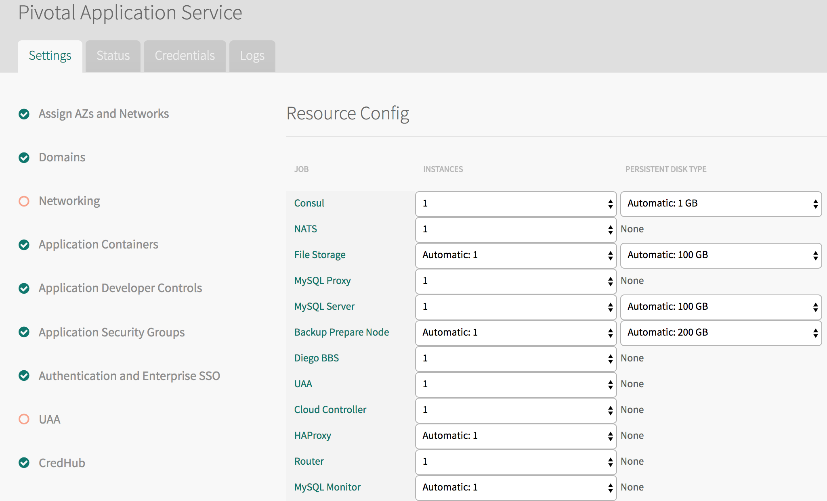
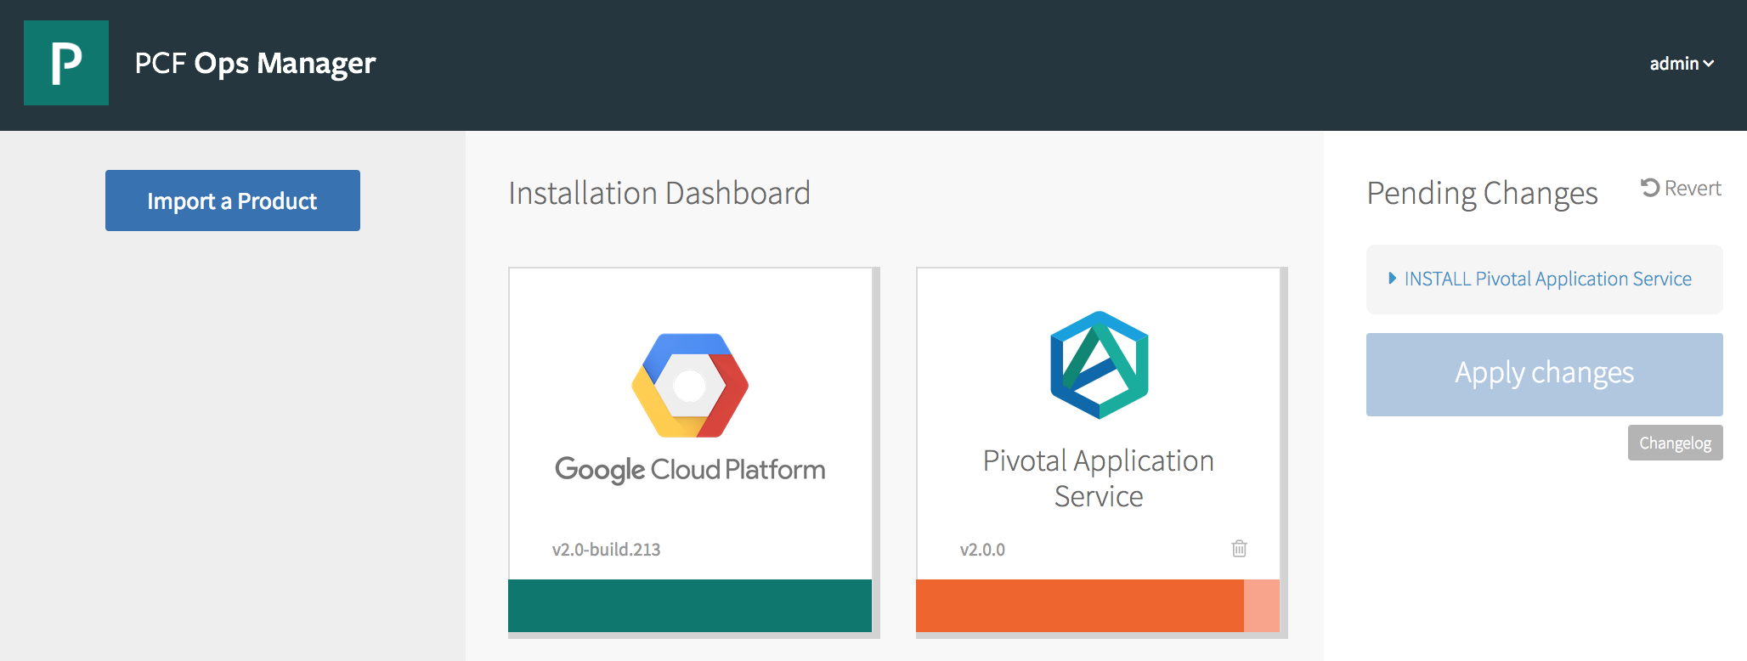
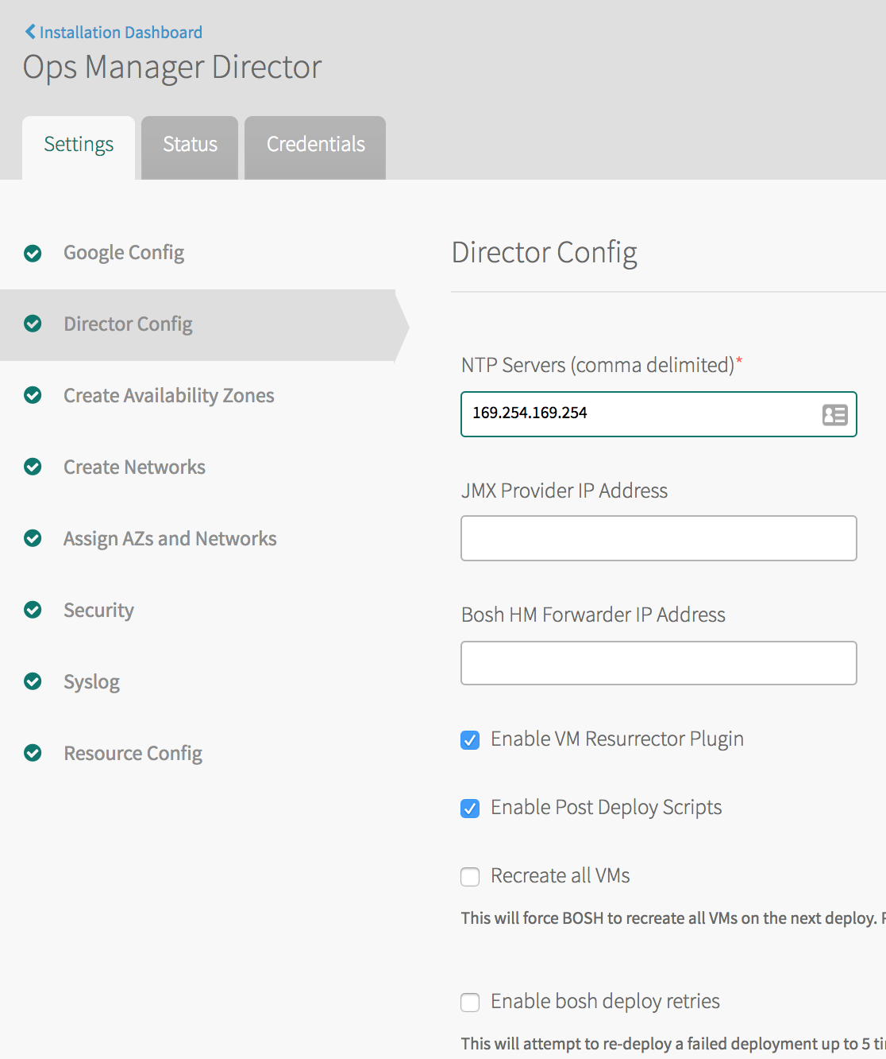
The Ops Manager

Slide 10

Why Use The Ops Manager? (1/2)
BOSH …
… is hard

Slide 11
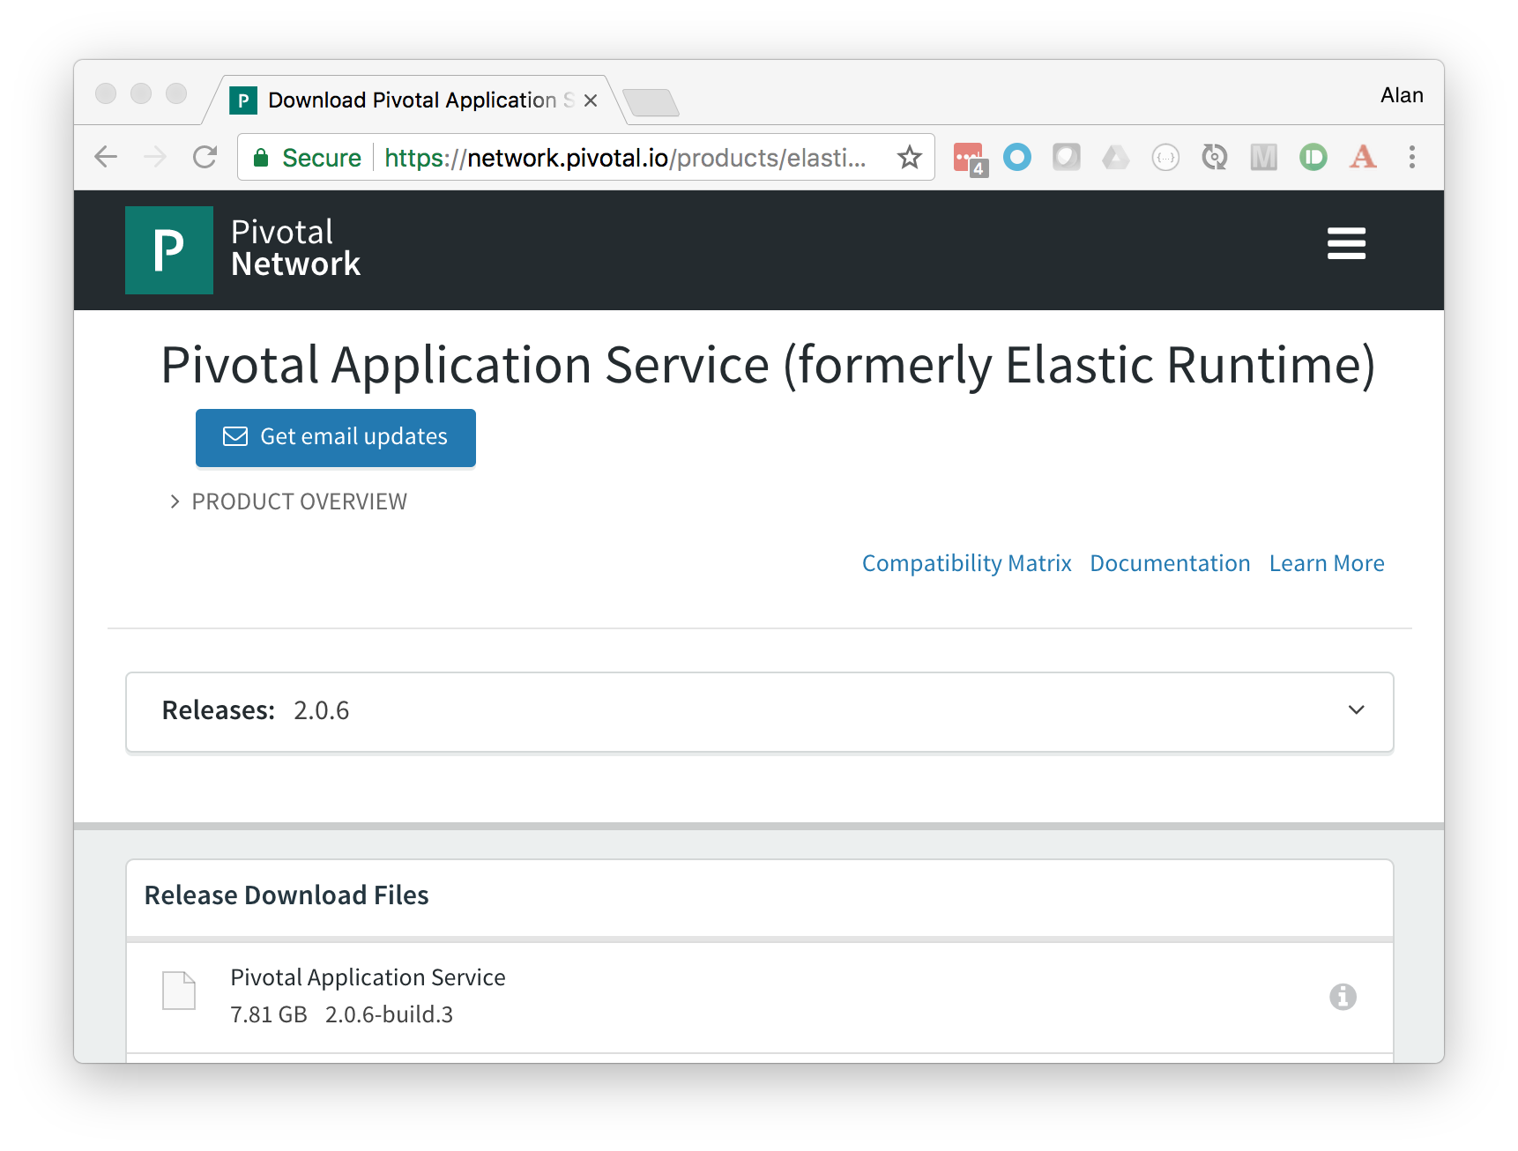
Why Use The Ops Manager? (2/2)
PivNet …
… is easy
and safe

Slide 12
The Ops Manager – Alternate Viewpoints
The cosy interface makes configuration seem easy. It’s not.
Webpage form validation won’t catch everything.
“Fat fingers” frequently fail.
What if we don’t have a browser at our disposal?
“I’ve got FIFTY of these things!”
Notes:
Prolonged use of the Ops Manager (in classroom or in the field) can yield some questions

Slide 13
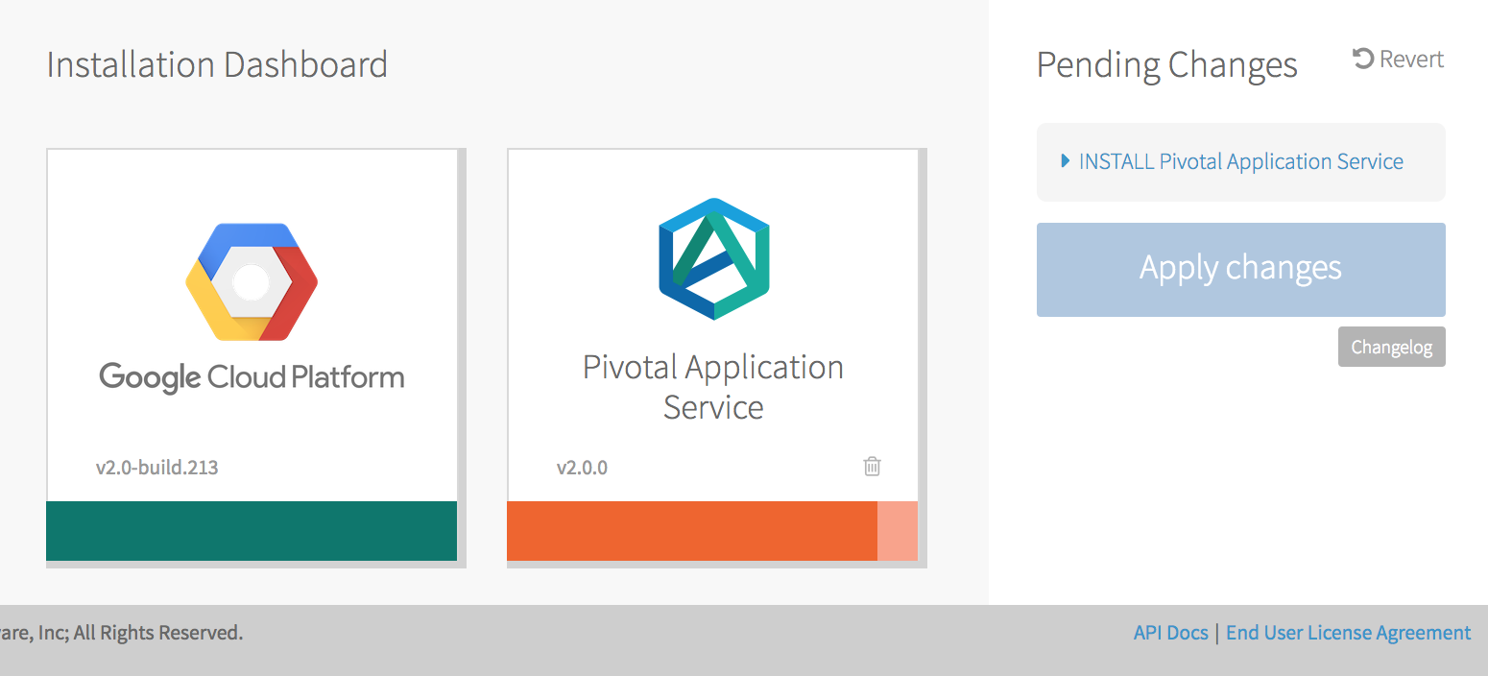
No More Pointy-Clicky (1 of 2)

Slide 14
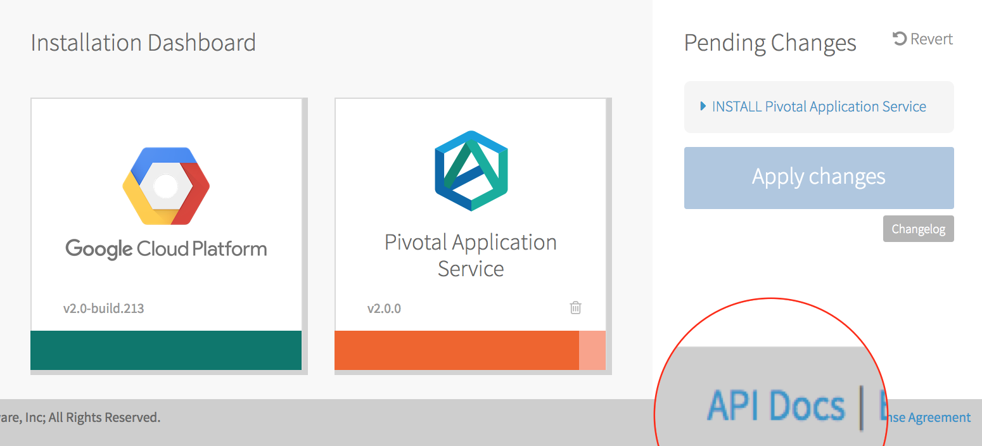

No More Pointy-Clicky (2 of 2)
Looks like you don’t actually wanna go home tonight.
Should I order pizza?

Slide 15


Why Would You Do This?
PivNet
OpsMan
Notes:
PivNet downloads up to 10GB in size

Slide 16

Back To The Future?
PivNet
Jumpbox
OpsMan
Notes:
SSH to a Jumpbox VM. But we no longer have our browser interface. What now?

Slide 17
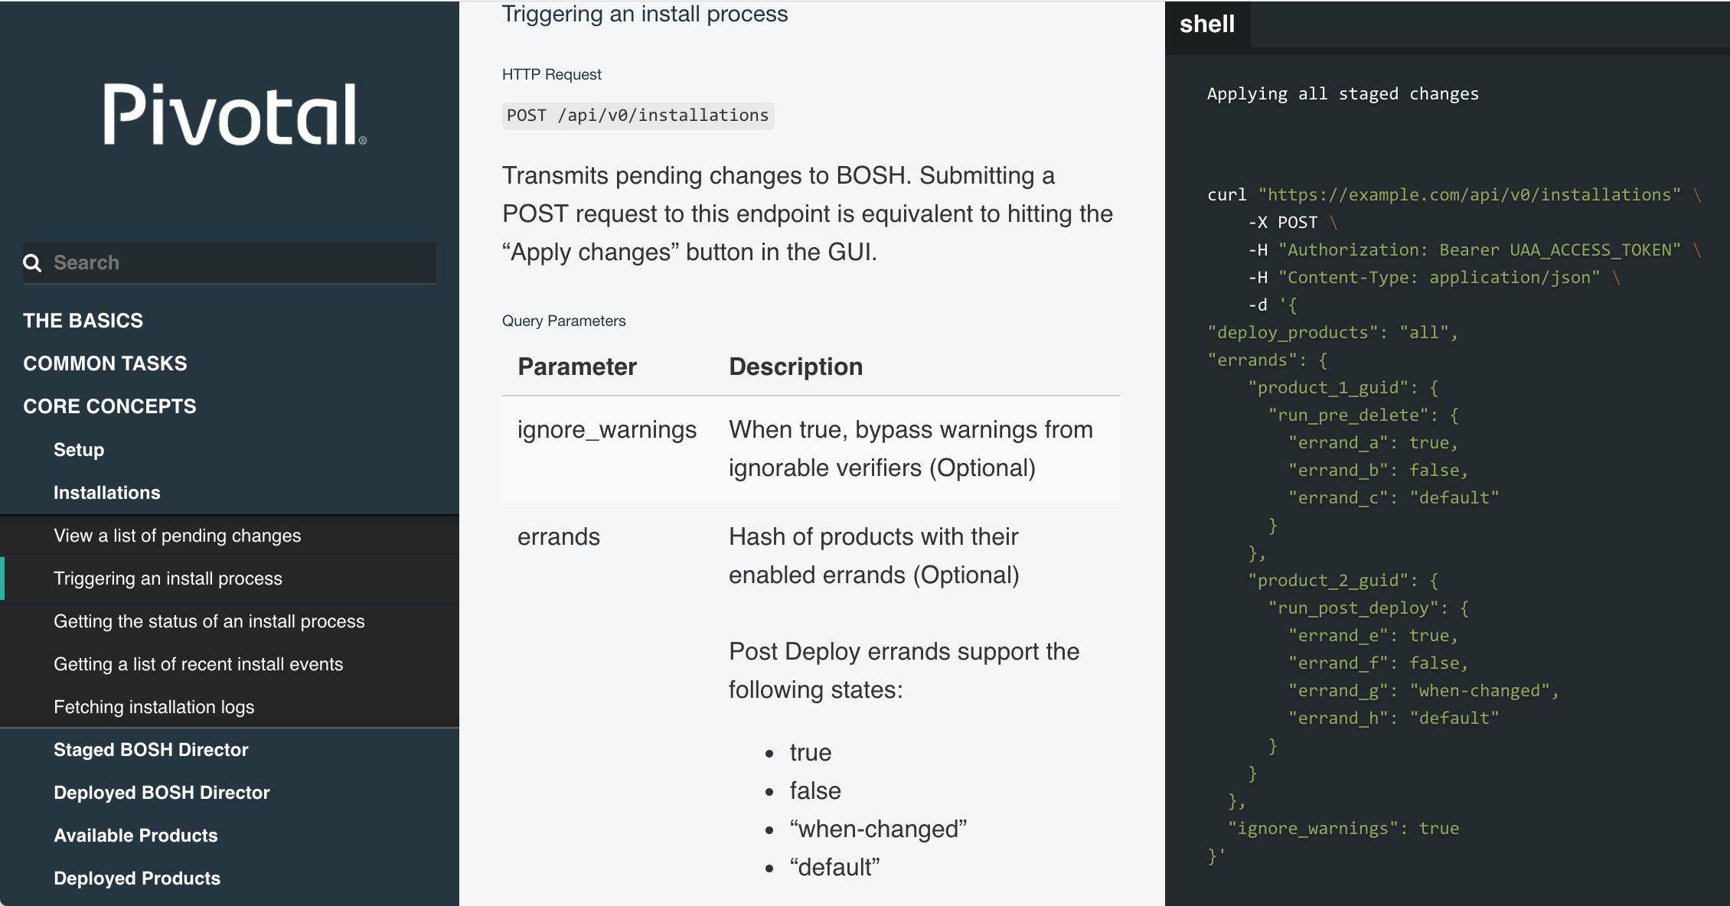
The Ops Manager API (/docs)

Slide 18
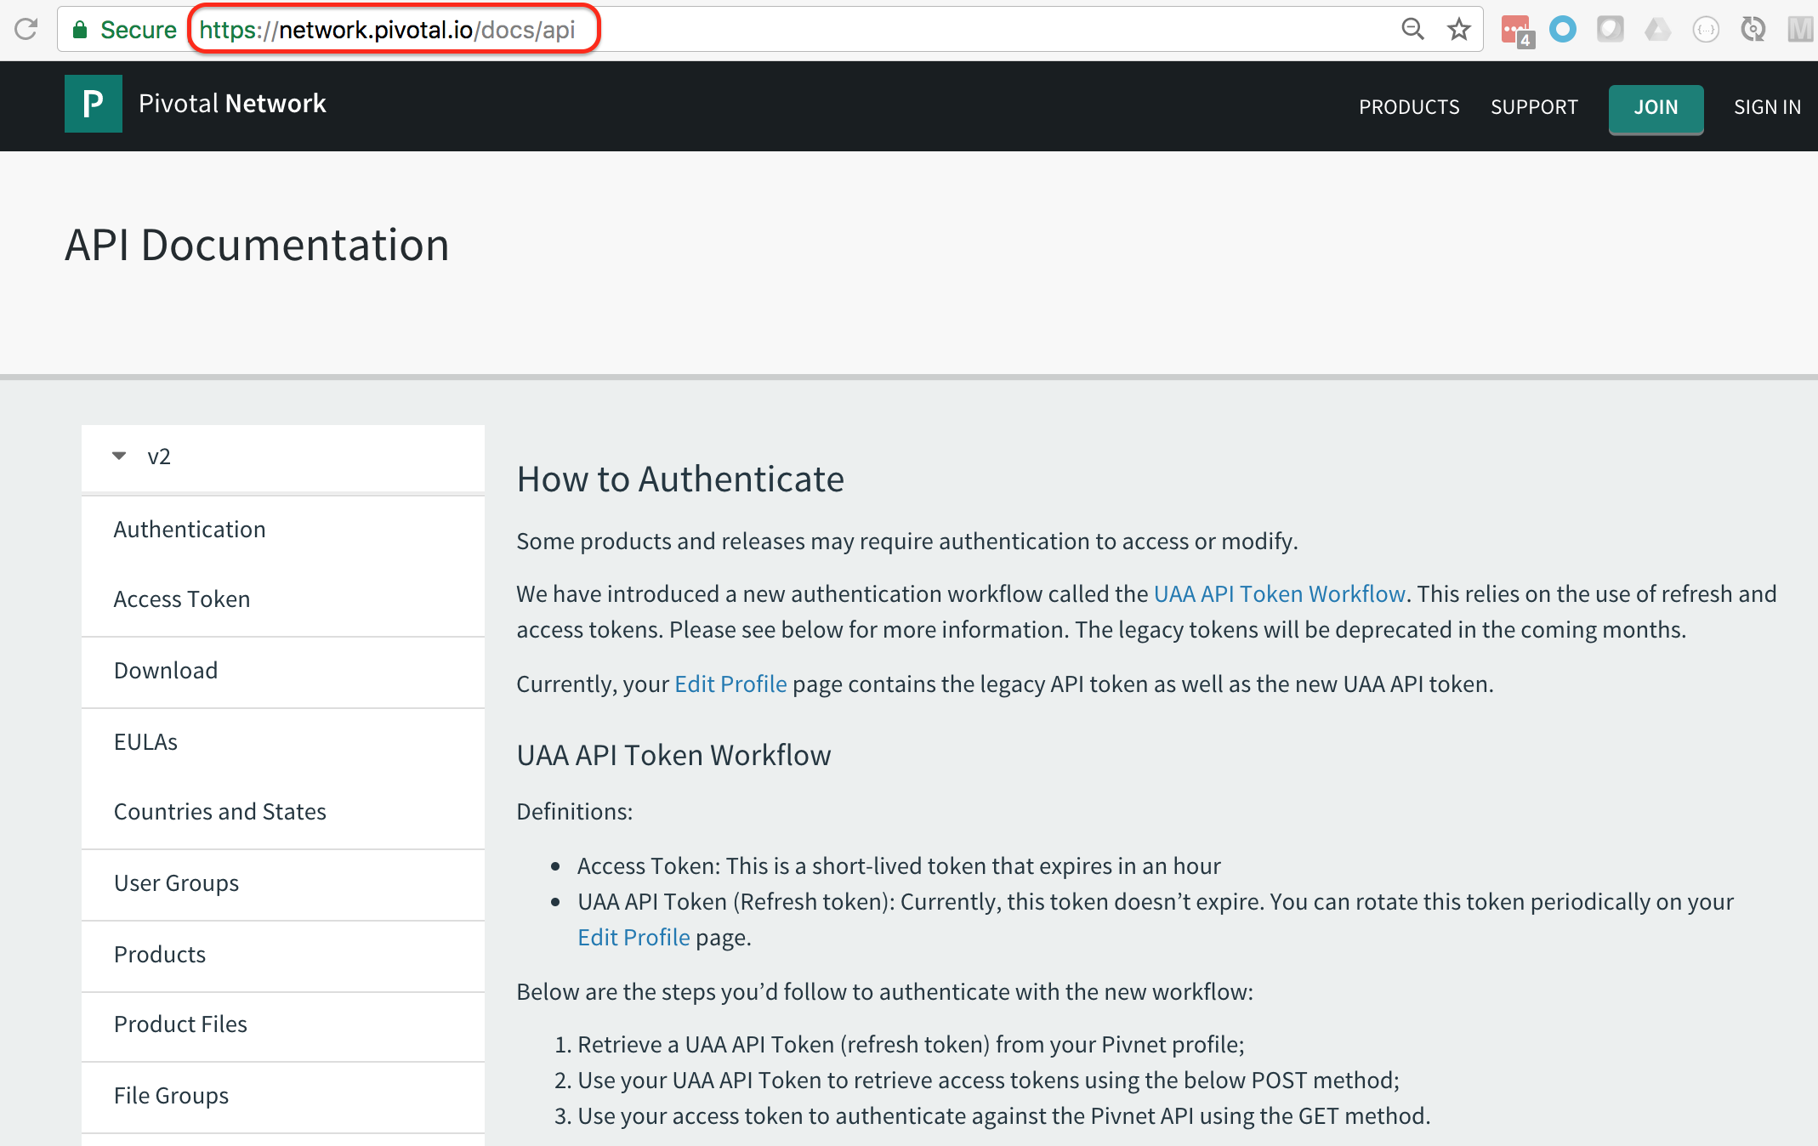
The Pivotal Network API (/docs/api)

Slide 19
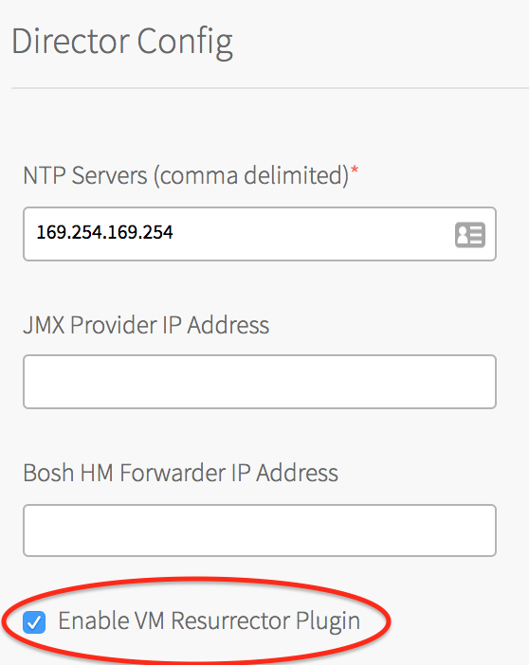
API GET requests via the browser (1 of 2)
The API documents the endpoints.
You can access GET method API requests via an authenticated browser session.
For example:
Navigate to https://YOUR_OPSMAN/api/v0/staged/director/properties
Find the resurrector_enabled entry in the resulting JSON.
The entry value should match the setting shown in the Ops Manager Director Config page.

Slide 20
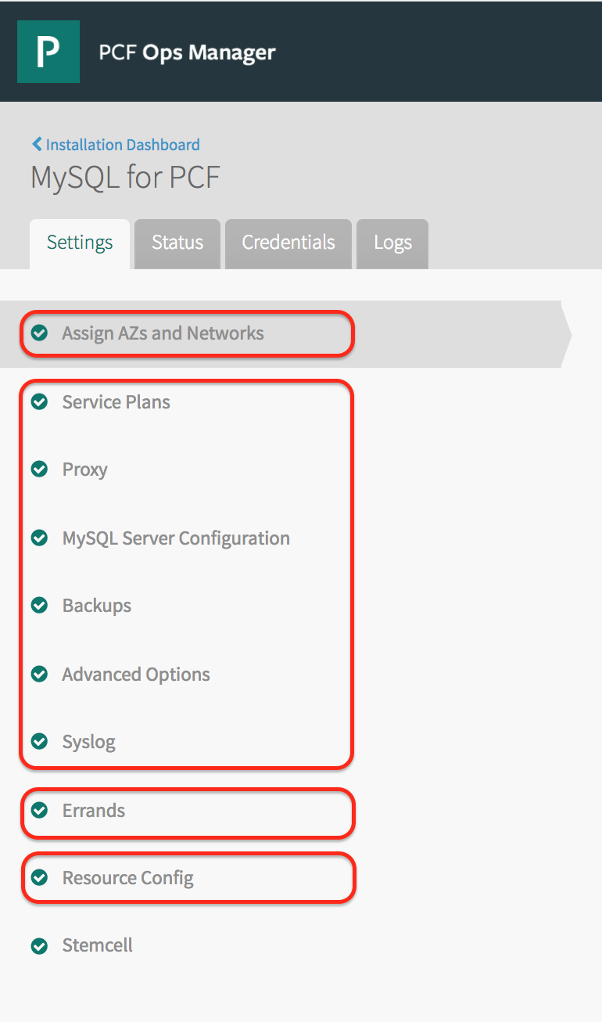
API GET requests via the browser (1 of 2)
Config for products is divided into four sub-parts, each with their own endpoints:
networks_and_azs .../api/v0/staged/products/<PRODUCT_GUID>/networks_and_azs
properties .../api/v0/staged/products/<PRODUCT_GUID>/properties
errands .../api/v0/staged/products/<PRODUCT_GUID>/errands
resources .../api/v0/staged/products/<PRODUCT_GUID>/resources

Slide 21
Curling over SSH (Ops Manager)
# AUTHENTICATE ADMIN USER AND EXTRACT ACCESS TOKEN
gem install cf-uaac
uaac target https://YOUR_OPSMAN/uaa --skip-ssl-validation
uaac token owner get opsman admin -s ""
TOKEN=$(uaac context | grep "access_token:" | tr -s ' ' | cut -d' ' -f3)
# VIEW ALL THE DIRECTOR PROPERTIES
curl -k "https://YOUR_OPSMAN/api/v0/staged/director/properties" \
-X GET -H "Authorization: Bearer ${TOKEN}”
# CHANGE ONE OF THE DIRECTOR PROPERTIES
curl -k "https://YOUR_OPSMAN/api/v0/staged/director/properties" \
-X PUT -H "Authorization: Bearer ${TOKEN}"
-d '{ "director_configuration": { "resurrector_enabled": false } }'

Slide 22
Curling over SSH (Pivotal Network)
# SEARCH PIVNET FOR MYSQL
curl "https://network.pivotal.io/api/v2/products" | \
jq -r '.products[] | [.name, .slug] | @csv' | grep '"MySQL for PCF"'
# IDENTIFY LATEST DOWNLOAD LINK
curl "https://network.pivotal.io/api/v2/products/p-mysql/releases/latest" | \
jq -r '.product_files[] | select(.aws_object_key | endswith(".pivotal")) | ._links.download.href'
# ACCEPT EULA
curl --header "Authorization: Token ${PIVNET_TOKEN}” --request POST \
"https://network.pivotal.io/api/v2/products/p-mysql/releases/53812/eula_acceptance"
# DOWNLOAD PRODUCT
curl --header "Authorization: Token ${PIVNET_TOKEN}" --location --output ${TARGET_FILENAME} \
"https://network.pivotal.io/api/v2/products/p-mysql/releases/53812/product_files/87255/download"

Slide 23
API All The Things (CF_TRACE)
> cf domains
Getting domains in org amcginlay as admin...
name status type
apps.amcginlay.gcp.pivotaledu.io shared
> CF_TRACE=true cf domains
Getting domains in org amcginlay as admin...
REQUEST: [2018-04-12T11:18:30+01:00]
GET /v2/organizations/677a283b-933d-43b3-8130-2541d14e8117/private_domains HTTP/1.1
...
RESPONSE: [2018-04-12T11:18:31+01:00]
HTTP/1.1 200 OK
...
{ JSON }

Slide 24
Command Line Tools
PivNet CLI (https://github.com/pivotal-cf/pivnet-cli)
Automates Pivotal Network GUI
Interrogates Product Versions
Accepts EULAs
Downloads Products
Downloads Stemcellls
“Om” CLI (https://github.com/pivotal-cf/om)
Automates Ops Manager GUI
Configures Authentication
Configures BOSH Director Tile
Imports & Stages Products Tiles
Imports Stemcells
Configures Product Tiles
“Hits” Apply Changes

Slide 25
Here’s One I Made Earlier
# SSH TO THE JUMPBOX (GCP)
gcloud compute ssh ubuntu@jumpbox
# FETCH THE CODE FOR THIS PRESENTATION
git clone https://github.com/amcginlay/ops-manager-automation ${HOME}/ops-manager-automation
cd ${HOME}/ops-manager-automation
# INSPECT THE GITHUB README.md !!!
# FAMILIARIZE YOURSELF WITH THE TOOLS AND REPO CONTENTS
./bin/om-linux --help
./bin/pivnet-linux --help
find ./scripts
find ./config

Slide 26
Environment Specific Variables (vars.txt)
# Each task script sources ./scripts/shared.sh which exports these variables
PCF_DOMAIN_NAME=mydomain.com
PCF_SUBDOMAIN_NAME=myenvironment
PCF_OPSMAN_ADMIN_USER=admin
PCF_OPSMAN_ADMIN_PASSWD=drowssaP_gnortS_emoS_42
PCF_PROJECT_ID=gcp-project-id-98765
PCF_REGION=europe-west1
PCF_AZ_1=europe-west1-b
PCF_AZ_2=europe-west1-c
PCF_AZ_3=europe-west1-d
PCF_PIVNET_API_TOKEN=RgJ6tSOMETHINGvxTssJ

Slide 27
The Money Shot
./scripts/configure-authentication.sh
./scripts/configure-director-gcp.sh
./scripts/mk-ssl-cert-key.sh
PRODUCT_SLUG="elastic-runtime" PRODUCT_VERSION="2.0.8" PRODUCT_FILE_ID="100587" \
./scripts/import-product.sh
IMPORTED_NAME="cf" IMPORTED_VERSION="2.0.8" ./scripts/stage-product.sh
IMPORTED_NAME="cf" ./scripts/configure-product.sh
./scripts/apply-changes.sh

Slide 28
The Productivity Pipeline

Slide 29

Register Today & Save!
September 24–27, 2018 Washington DC Gaylord, National Harbor
Discount Code
Attendee_CFSummit_100

Slide 30
You Have Been Watching
Alan McGinlay - Pivotal
Email: amcginlay@pivotal.io
Twitter: @amcginlay
LinkedIn: /in/amcginlay
GitHub: amcginlay
See You Soon!

